Slide 1
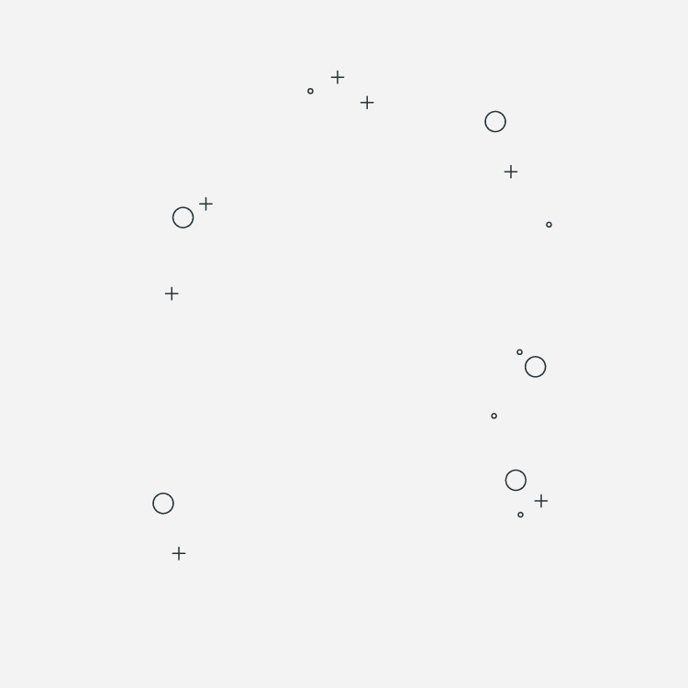

TruEvent Horizons
PROJECT PROPOSAL
Event Planning Management System

Slide 2

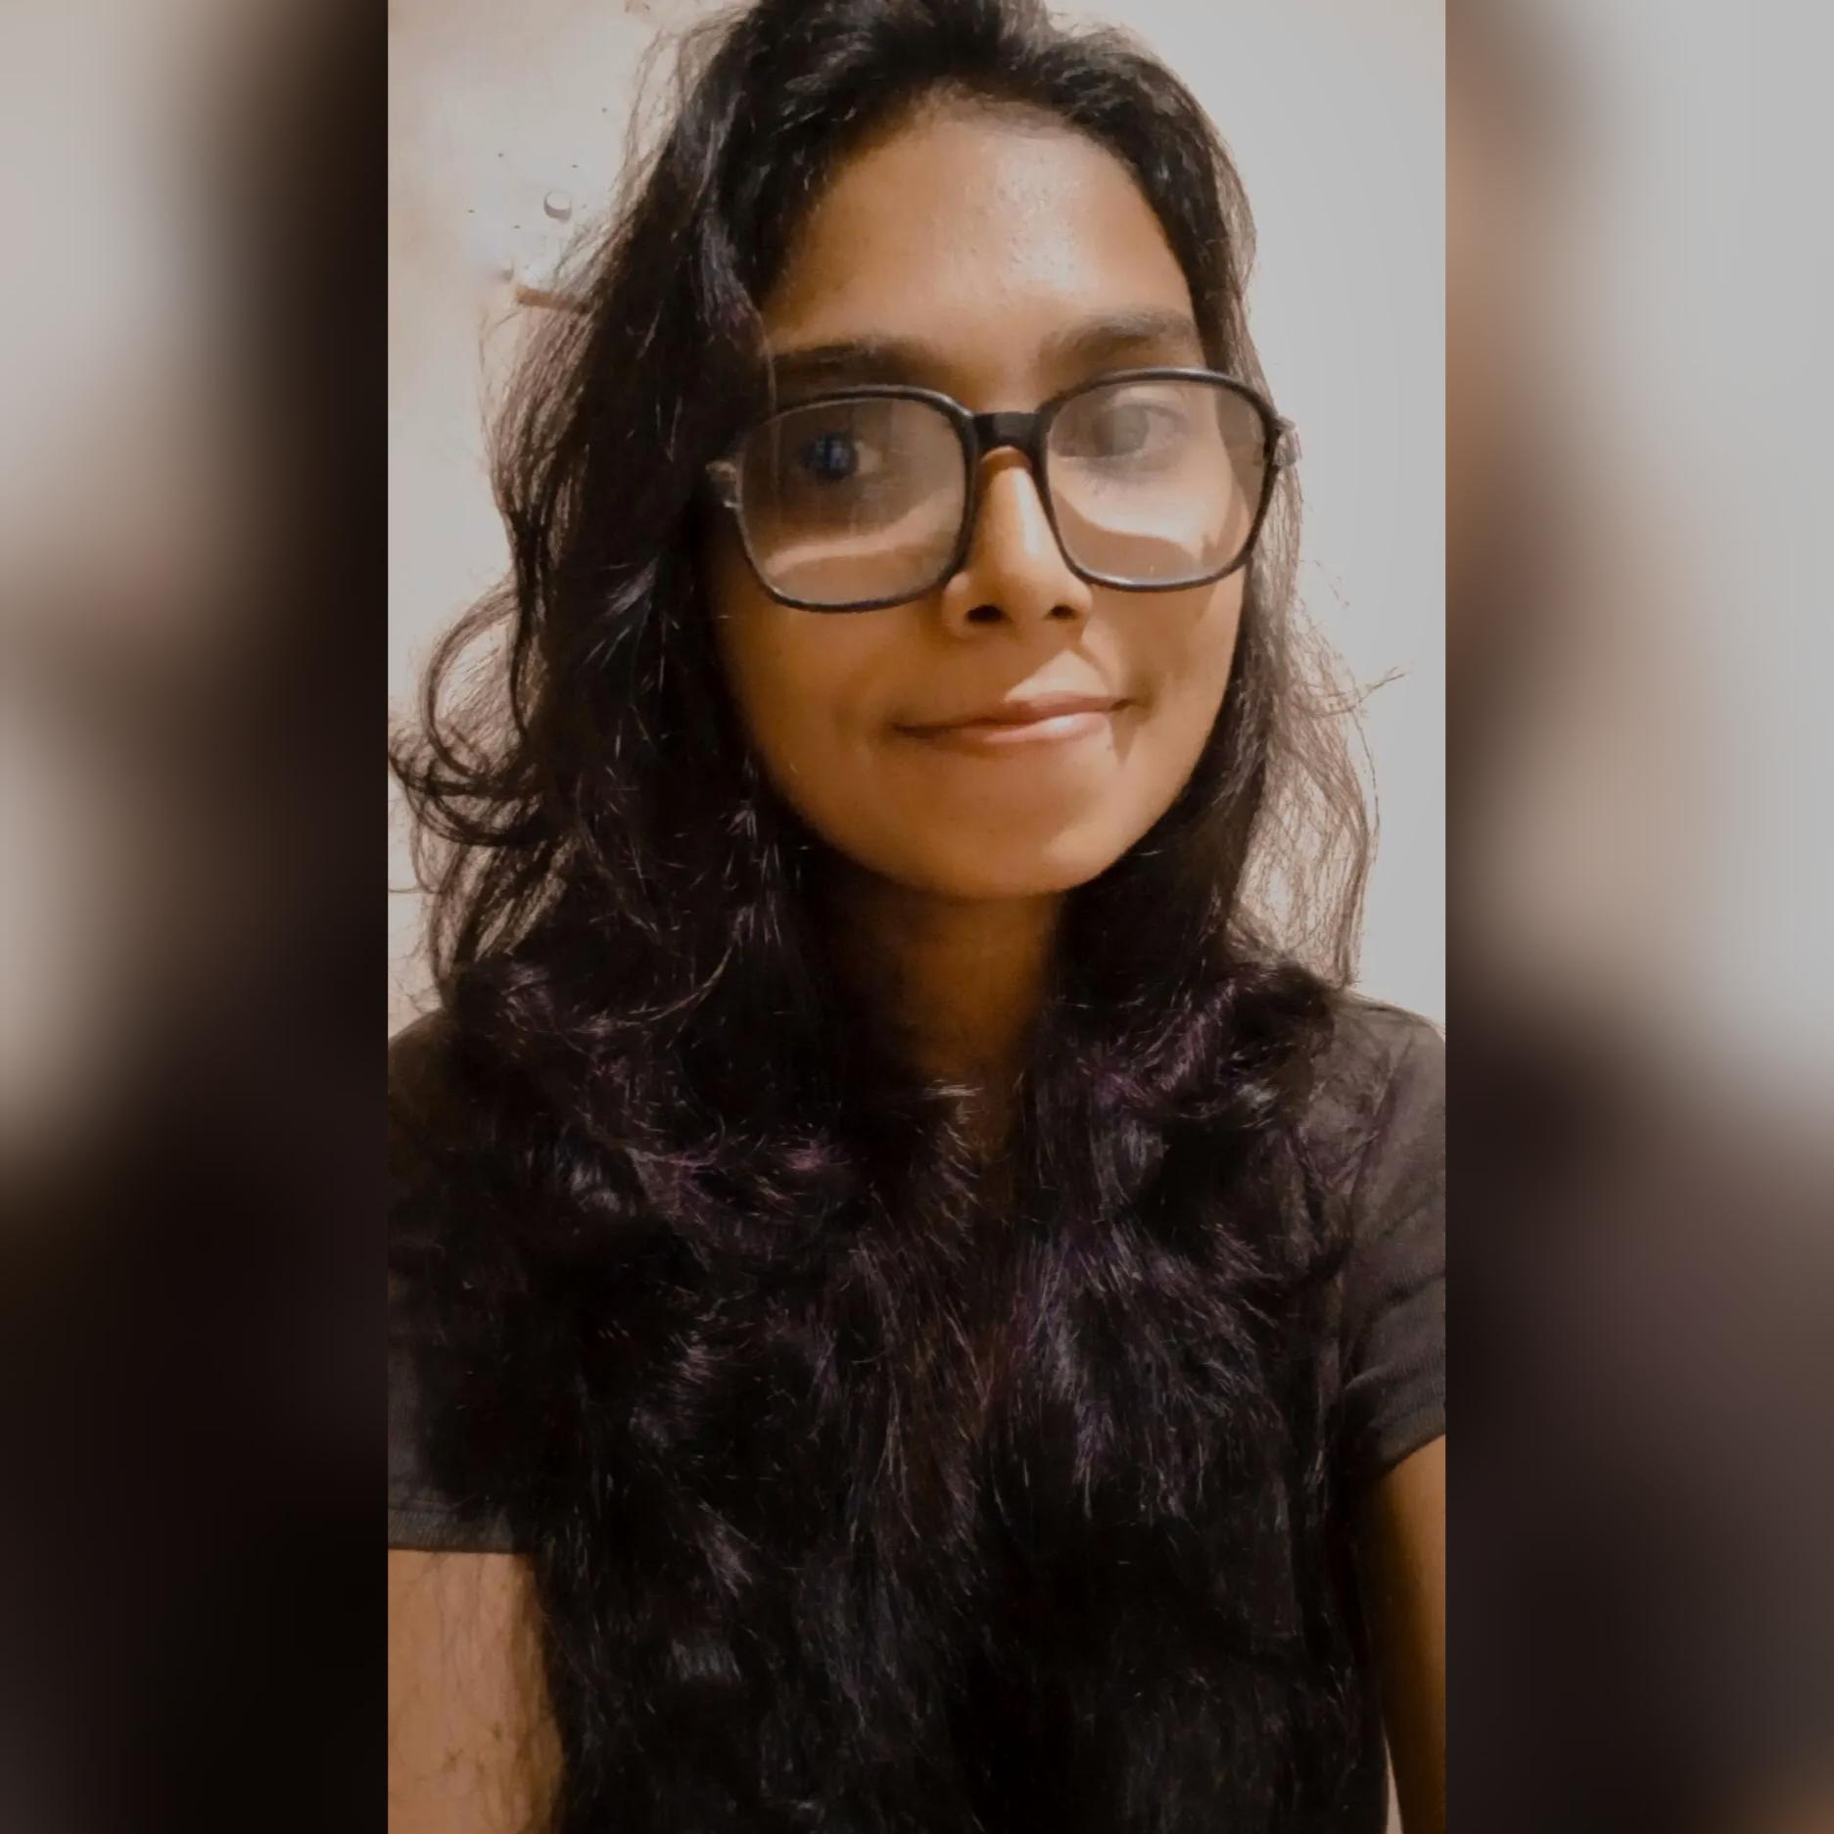

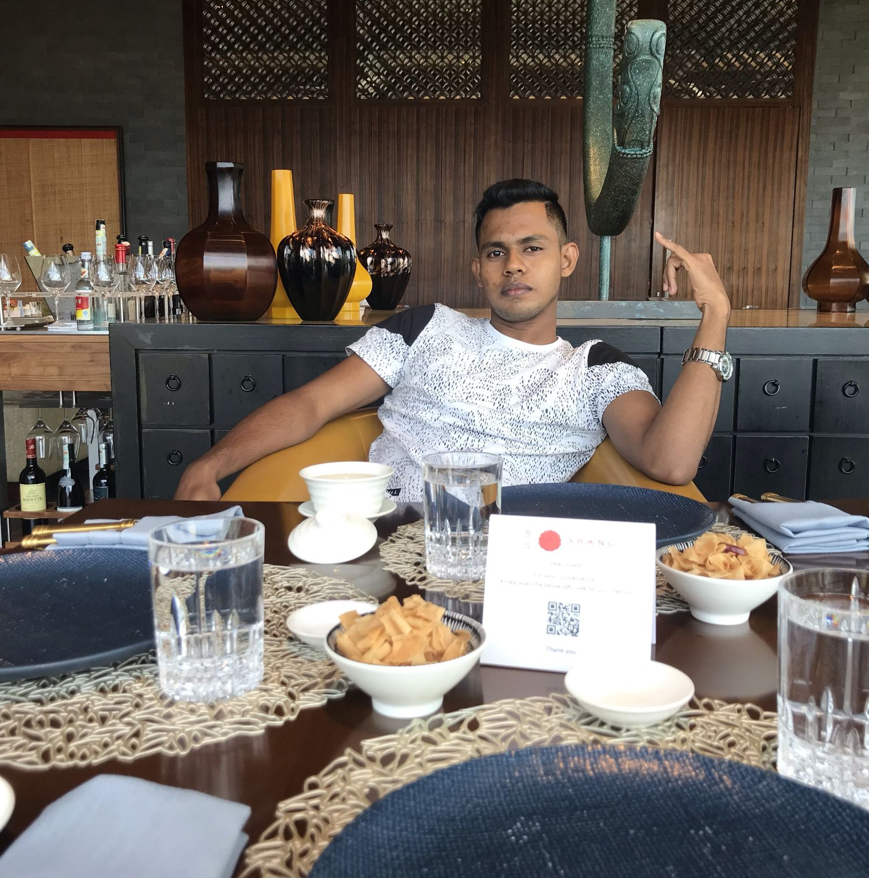
Group Members - CS 41
Saneru Akarawita
20000073
Harini Jayawardhana
20000881
Chirasi Walpola
20001975
Kaveesha Muthukuda
20001185
Supervisor : Mr. Roshan Abeyweera
Co-Supervisor : Ms. Akna Delgodaarachchi

Slide 3


Slide 4

01
ABOUT THE
PROJECT

Slide 5


TruEvent Horizons is an event planning management system which facilitate a common platform to customers and service providers when it comes to event planning activities.
The main goal of this project is to satisfy both customers and the service providing clients of the event planning system by managing the majority of the organizational work within our system with minimum user effort and time.

Slide 6
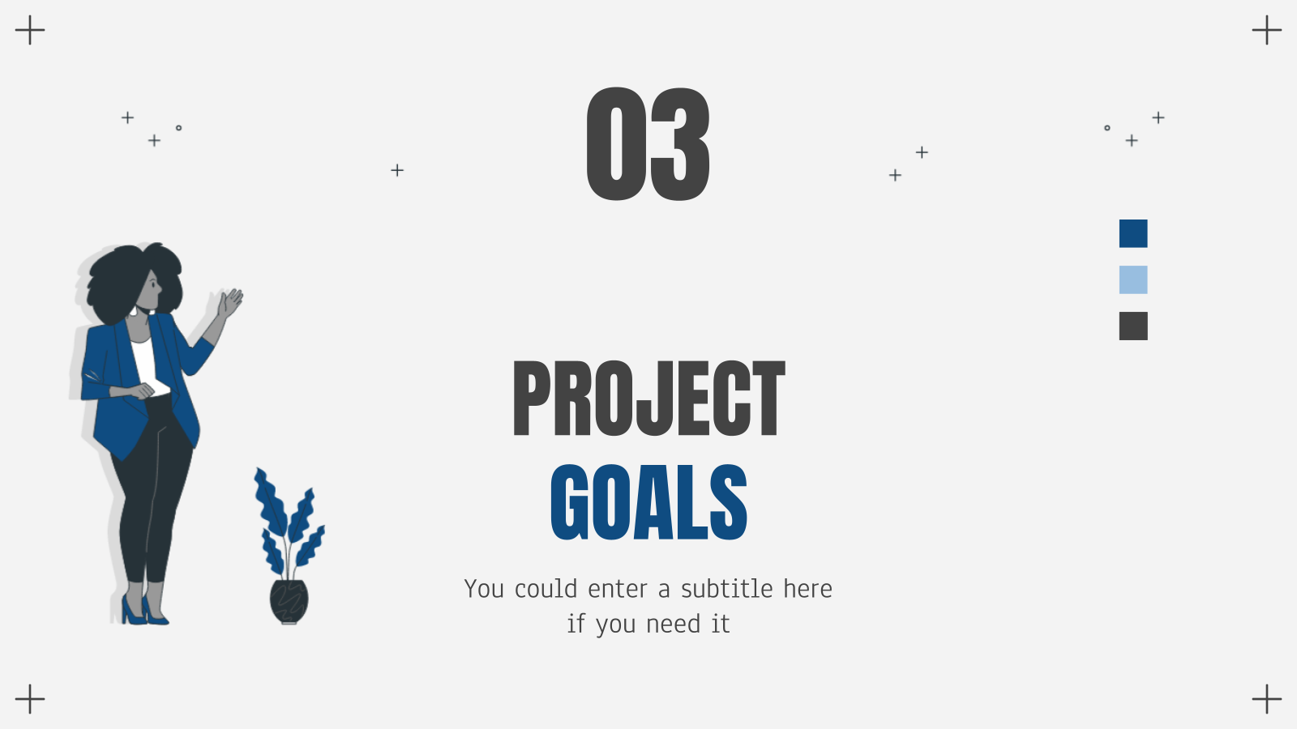
02
PROJECT
DESCRIPTION

Slide 7

PROBLEM
Service Seeker Point of view:
There is no common platform (all in one platform) for the customers to visit and go through their event reservation needs.
Even though there are websites for respective services individually, those websites do not give a clear idea about the overall event plan with all the services included.
Customers waste a large amount of time, money and effort in traveling and visiting each service place and clients individually and physically.
It is hard to compare all the price levels of each service and package to choose the best possible services.

Slide 8
PROBLEM
Service Provider Point of view:
At the end of the month, it is a very tedious task to manually go through all the service logs to generate reports.
Some service providers might not have their own websites.
Difficulties arise when customers try contacting service providers because sometimes mobile numbers might not work and sometimes the respective service client might be on another call.

Slide 9
SOLUTION
Reservation Management
Services/Packages Management
Payment Management
Report Generation
1
2
3
4

Slide 10

03
REQUIREMENT ANALYSIS

Slide 11
User Identification
Customer
Hotel Manager
Band Manager
Photography Company
Deco Company
System Admin
Super Admin

Slide 12

FUNCTIONAL
REQUIREMENTS

Slide 13
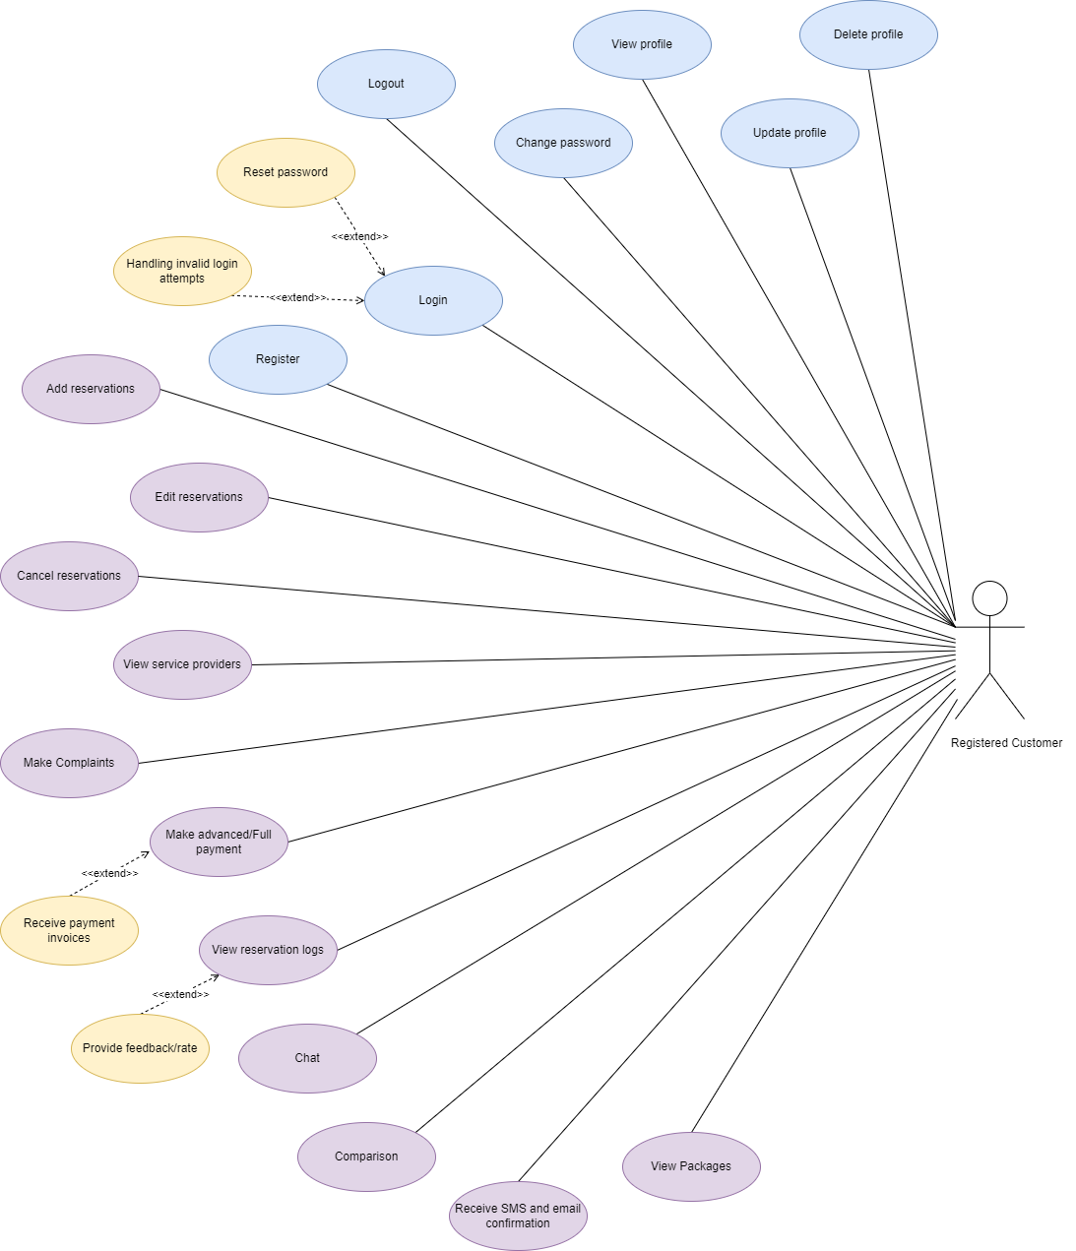
Customer
Register
Login
Logout
View/Update/Delete Profile
Change Password
Add/Edit/Cancel Reservations
View Service Providers/Packages
Make Payment
Make Complaints
Chat Option
View Reservation Log
Comparisons

Slide 14
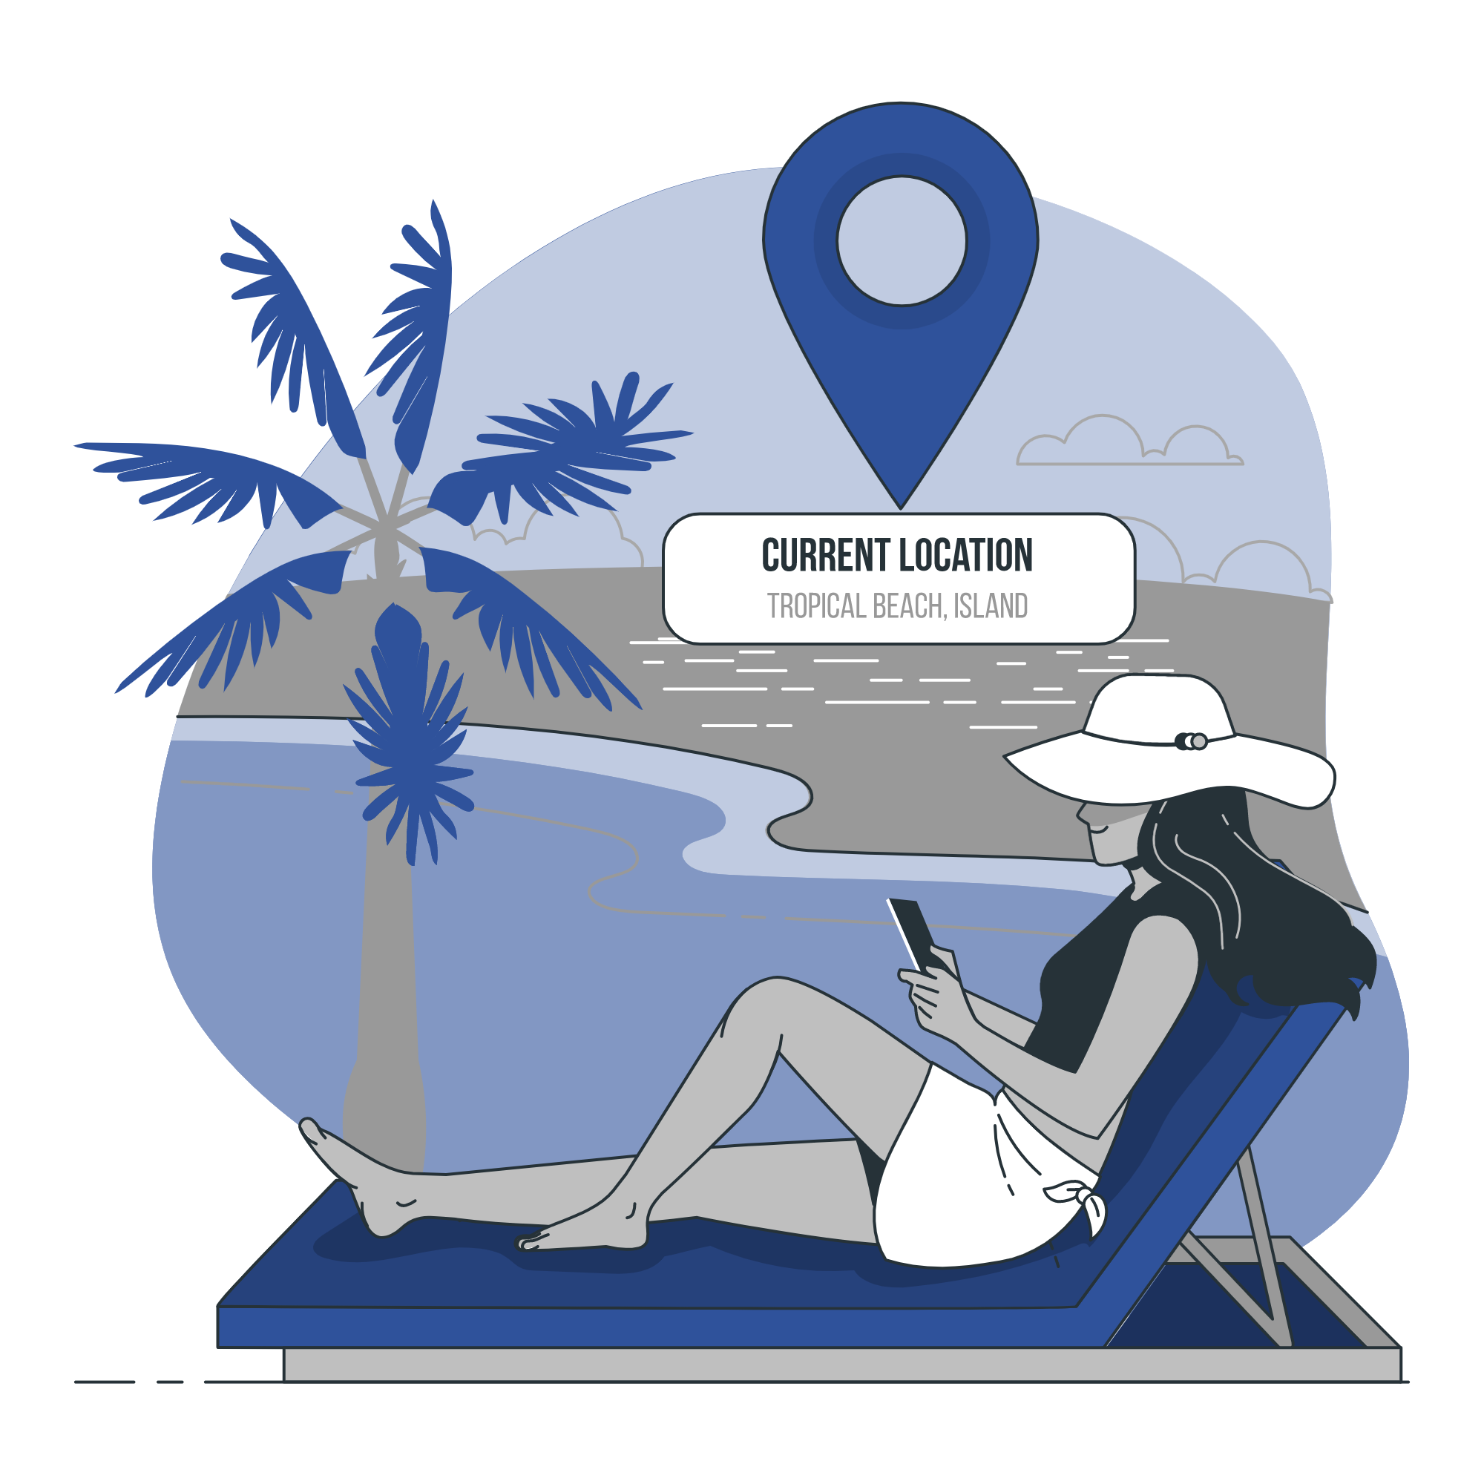



Service Provider

Slide 15
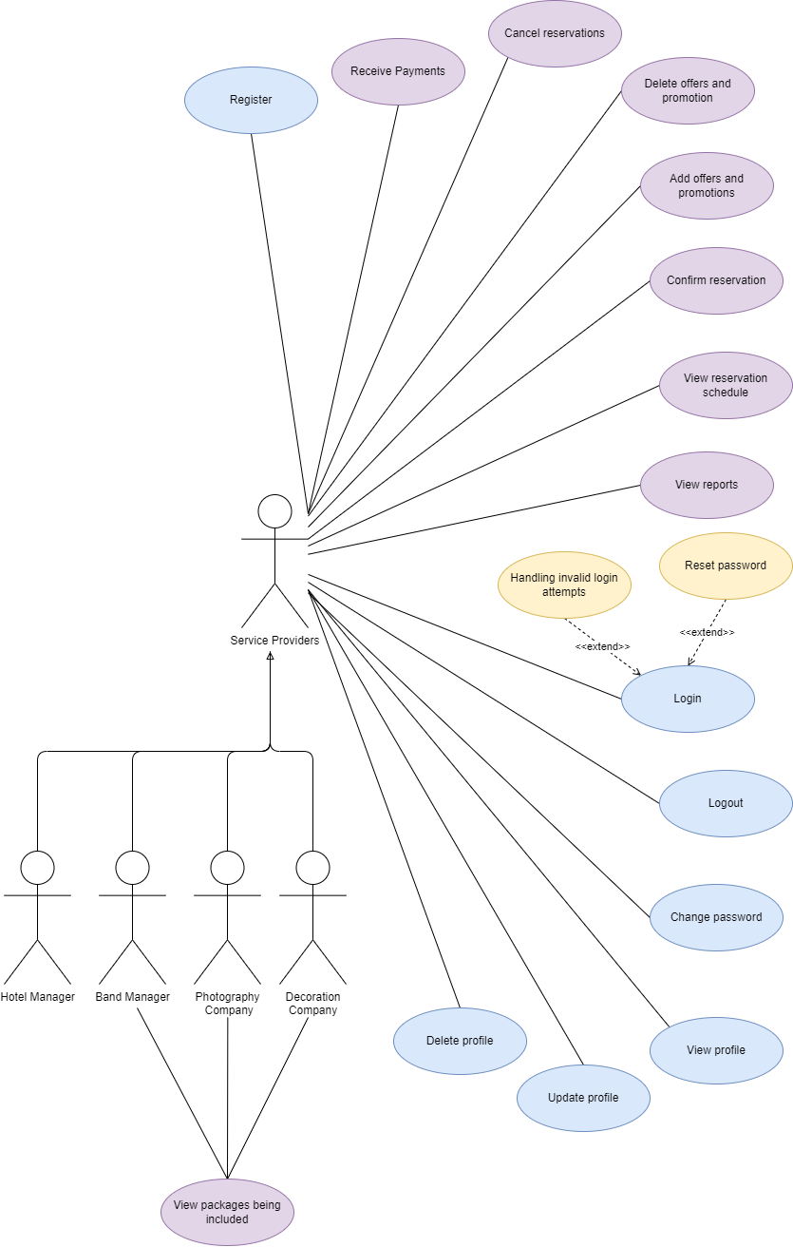
Service Provider
Register
Login
Logout
View/Update/Delete Profile
Change Password
Receive Payments
Cancel/Confirm Reservations
Add/Delete Offers and Promotions
View Reports
Chat Option
View Reservation Log
View Packages being included **

Slide 16
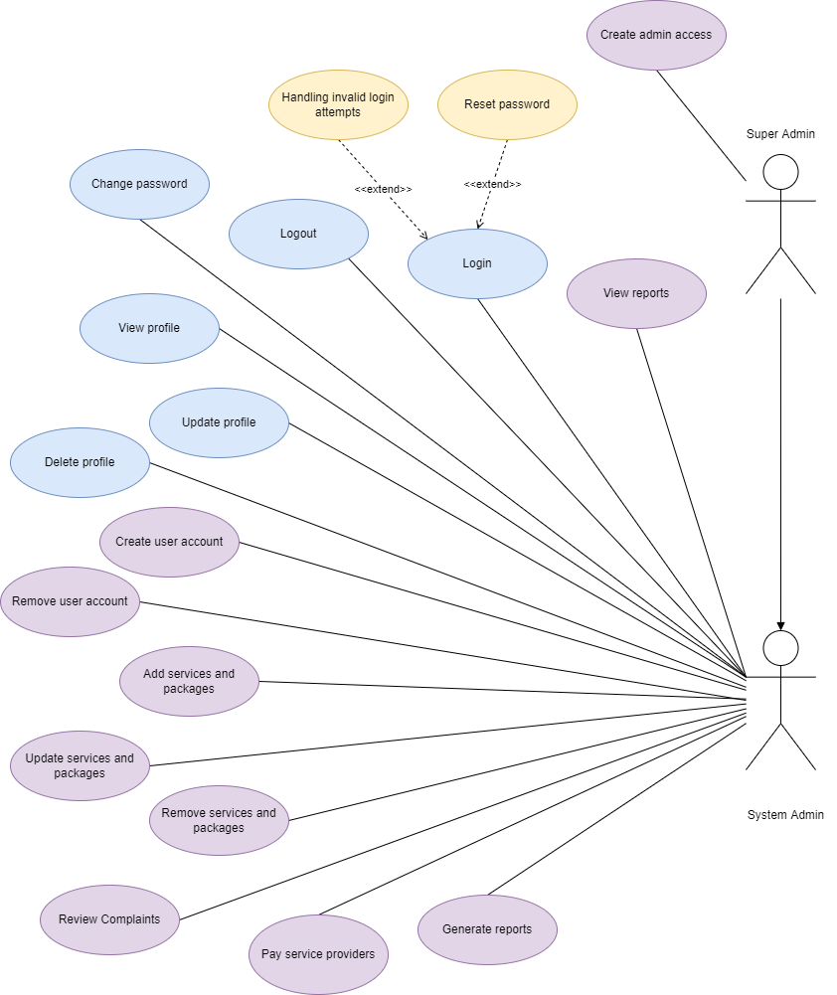
System Admin
Login
Logout
View/Update/Delete Profile
Change Password
View Reports
Create/Remove User Accounts
Add/Update/Remove Services/Packages
Review Complaints
Pay Service Providers
Generate Reports
Chat Option
Create Admin Access - Super Admin

Slide 17

System Boundary
In scope
Online reservation management.
Services and packages management.
Applying promotions
Payment Handling
Report and payment invoice generating.
Out of scope
Inventory management related to the products used in the system service platforms.
Food catering under hotel reservations.
Adding a new service providing category (other than the given ones) dynamically is not being handled by the system.
Other than the reservation management system, the internal business processes of the other management systems will not be covered in the system.
When finding the recommended hotels near to the user location, pre-made “Recommended Systems” will not be used.

Slide 18

QUALITY
ATTRIBUTES

Slide 19


User-friendliness
The system shall be able to be used easily by the users without requiring a high level of knowledge to understand the operations. the proposed system shall be used by its users comfortably. The provided should be easily accessible and navigable.
System shall require a minimum level of IT and English knowledge to operate.
Systems should have user interfaces with minimal but clear designs.
confirmation and pop up messages shall provide a clear idea of the actions that the user performs.
Modifiability
The system may require updates and modifications from time to time so the system must be flexible for changes and updates anytime.
Designing the system as components and having minimum dependencies shall provide the required modularity to accommodate changes easily with less modifications.
Thus, the system shall be modified to add new components with minimum effort.

Slide 20

Security
System is designed with a proper hierarchy that separates the accessibility of each user level, it shall restrict access to unauthorized operations and data access.
Every login is processed with authentication of credentials.
Passwords are stored using encryption to secure login details if any unauthorized access occurs.
OTP being sent to customers via SMS and email when recovering/changing passwords.
Performance
System should respond to the events without any significant delay that may affect the overall usability of the system.
System shall be tested for its efficiency of response and improve it by using optimized scheduling algorithms.
Database shall be normalized to reduce data redundancy and by that it shall allow retrieval of data efficiently by minimizing the delay.

Slide 21

04
HIGH LEVEL SYSTEM ARCHITECTURE

Slide 22
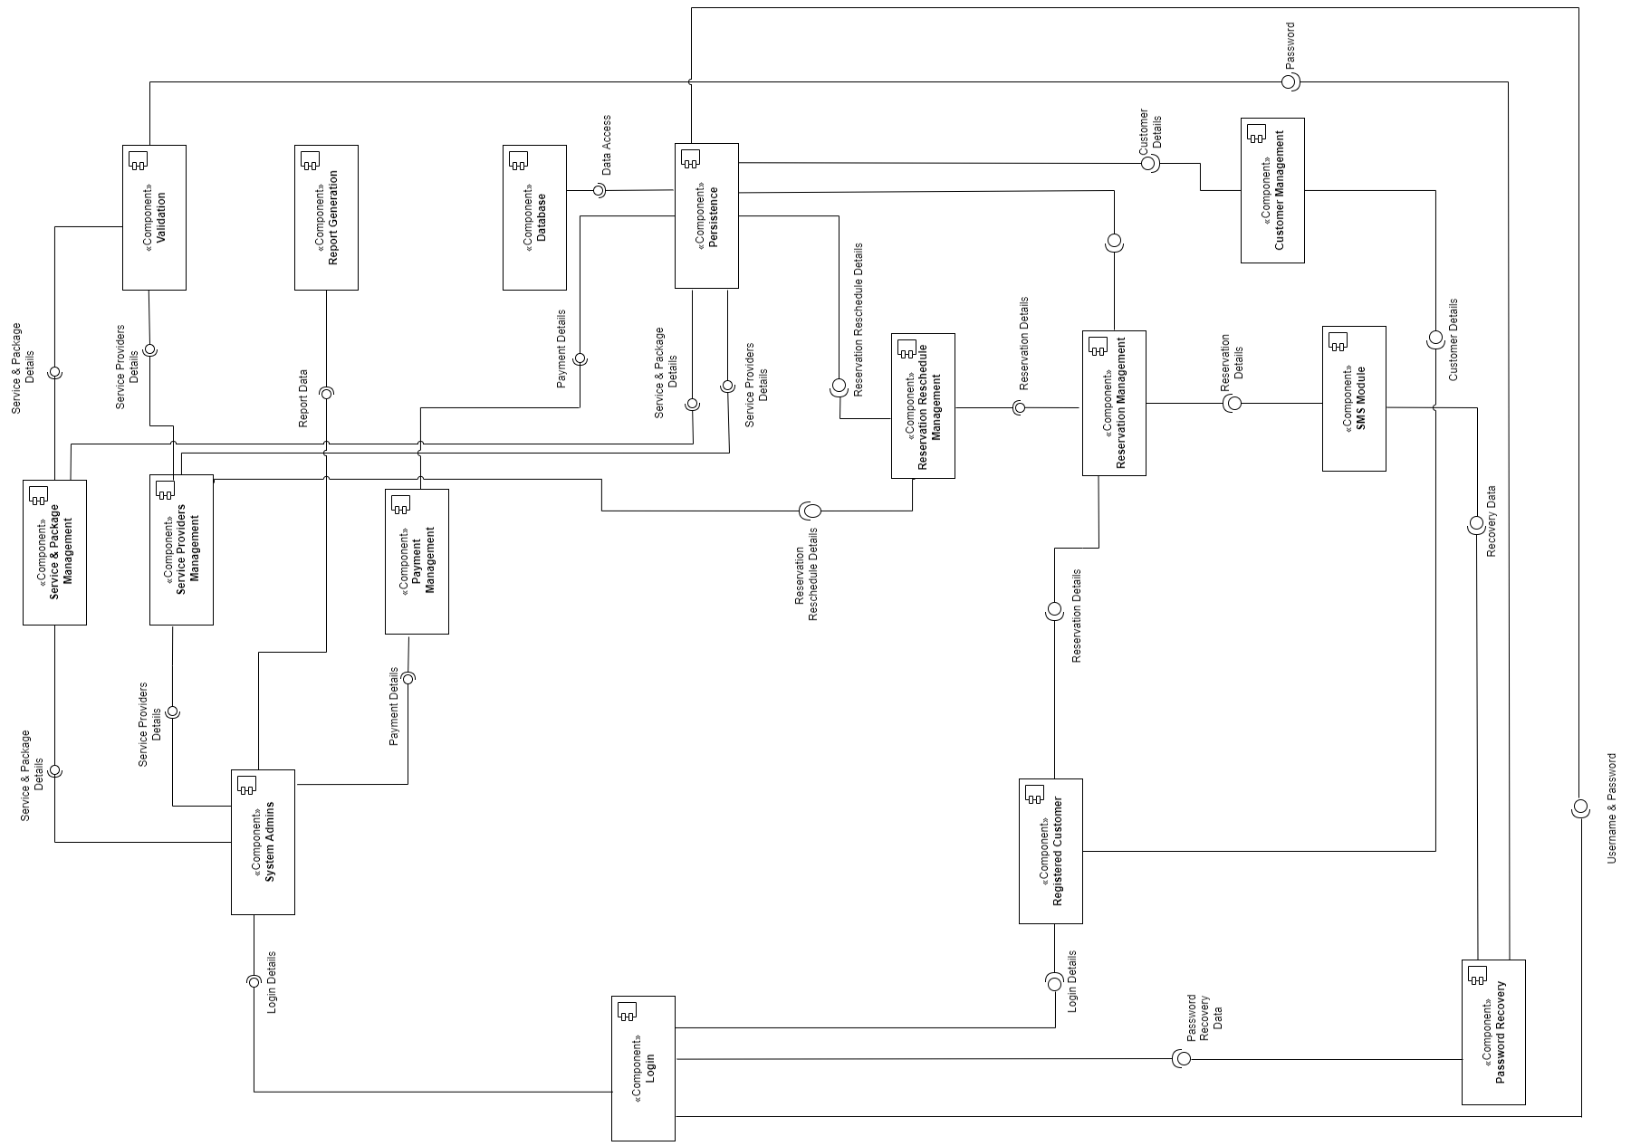

Slide 23
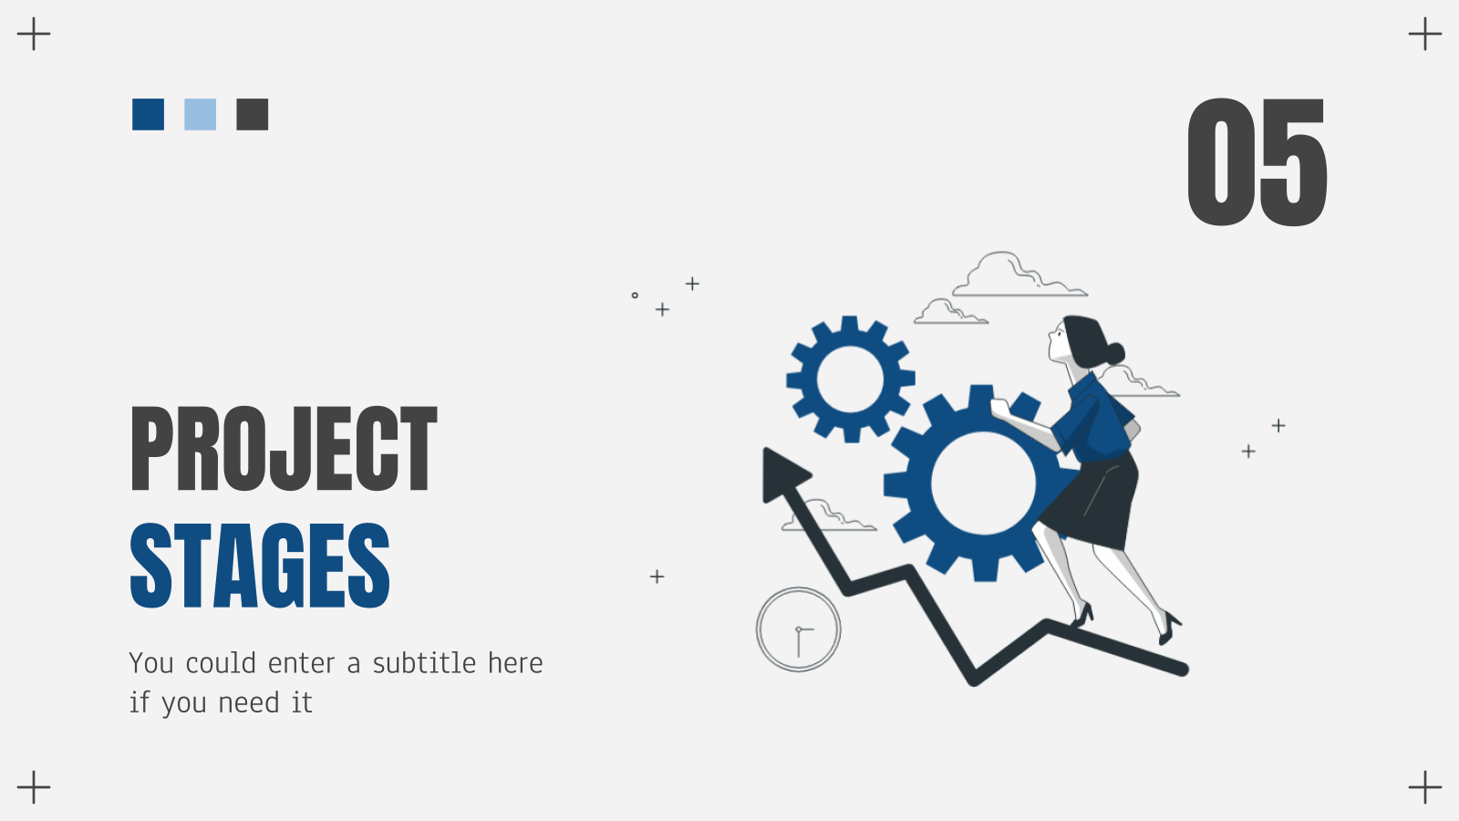
05
FEASIBILITY
STUDY

Slide 24
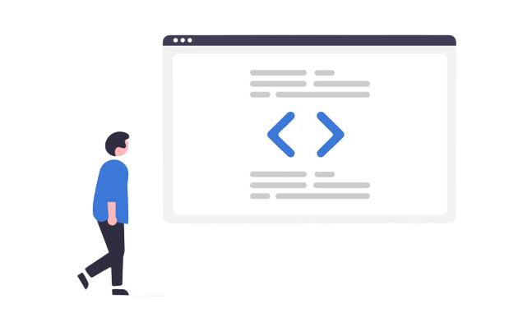

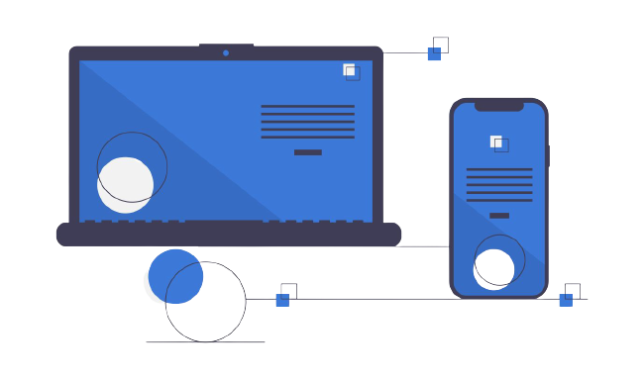

Technical
Feasibility
Technologies used for Front-end, Back-end and Database are well suited for the system design and have community support.
a payment sandbox will be used to handle the payments in the system.
development team is familiar with working with the aforementioned software and technologies.

Slide 25


Economic
Feasibility
The cost of the SMS API and the cost for Hosting is considerably low and affordable and will be covered by the system charges.
All software applications and tools are free and open-source.
No additional cost for the hardware components.
The cost can be covered with the profit we keep from the customers as well as the service providers throughout the year.

Slide 26
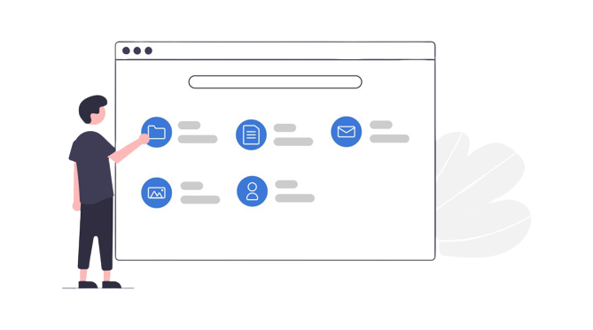
Operational
Feasibility
Considering the issues that were identified, the proposed system provides multiple subsystems addressing all functionalities required by the service providers and the customers.
The following survey results shows that the proposed system satisfies the requirements of the users and they are being addressed accordingly.

Slide 27
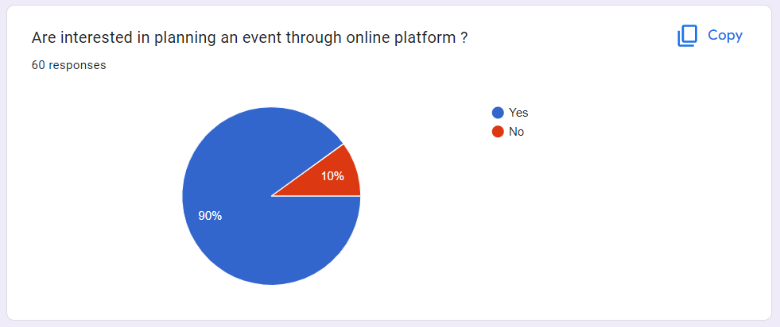

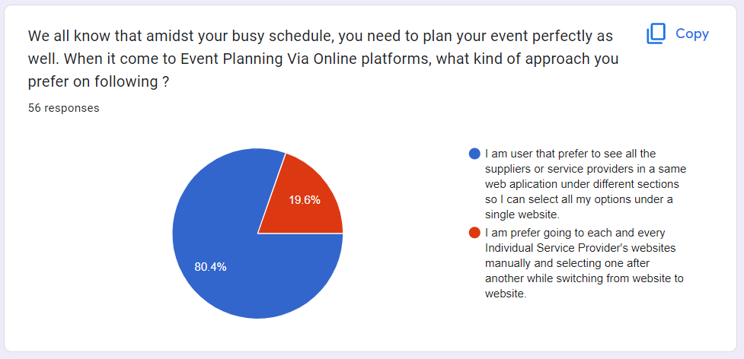

Slide 28
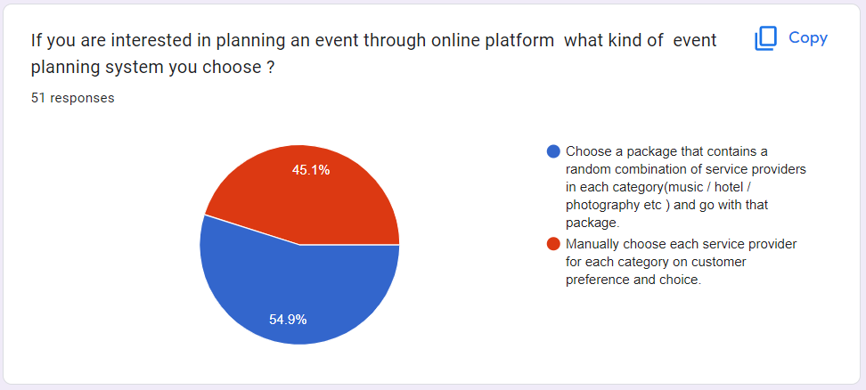
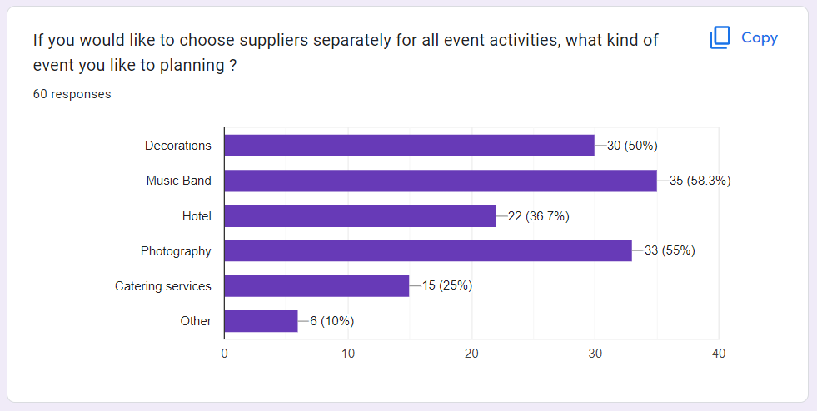

Slide 29



Schedule
Feasibility
The development of the system should completed within 9 months left.
Requirement gathering phase is already completed
The available time duration is adequate for the for the development team of 4 members.

Slide 30
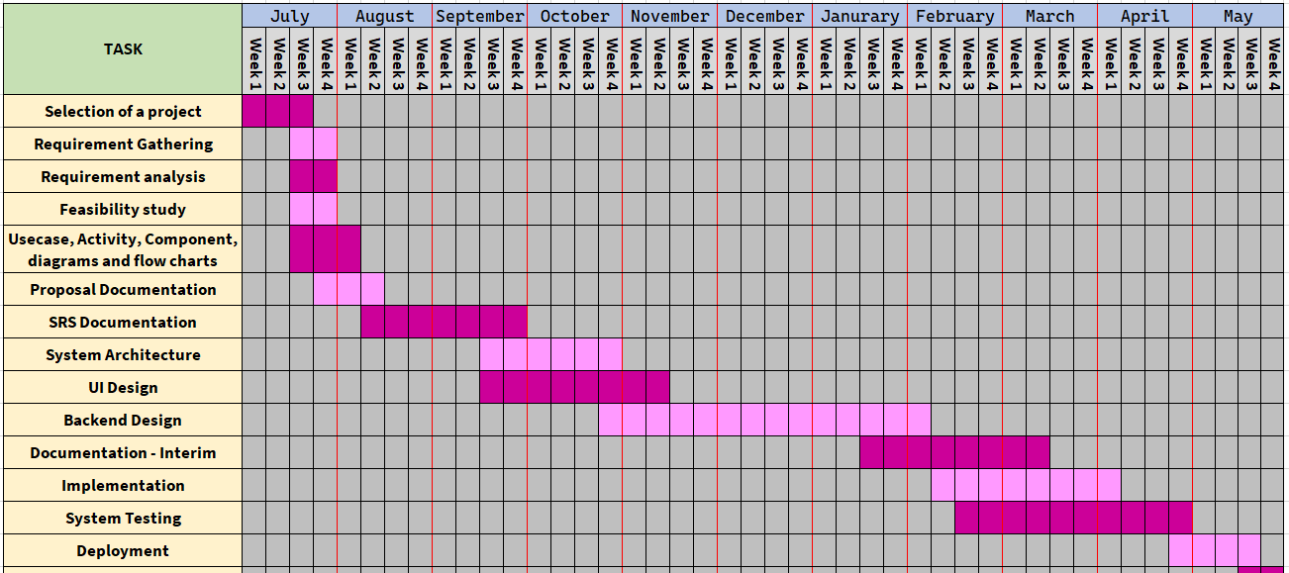
Gantt Chart

Slide 31
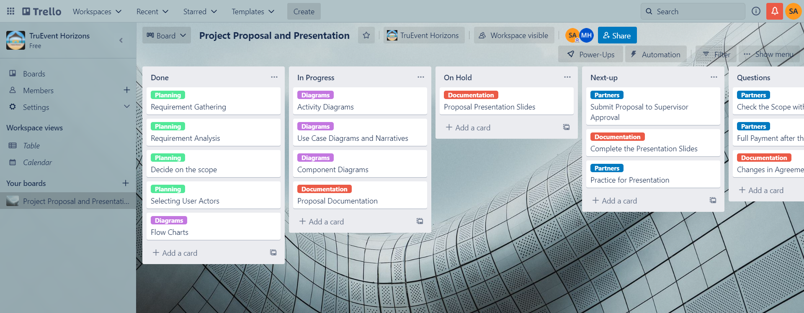
Trello Workspace

Slide 32
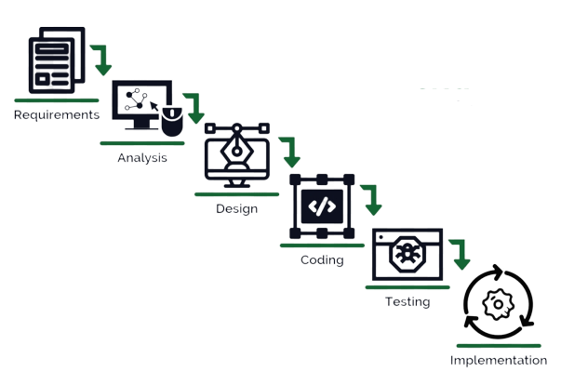
Software Development Methodology
Modified
Waterfall Model

Slide 33



Legal and Ethical
Feasibility
If any external code fragments used they will be acknowledged and give credits to its rightful owner
Customers who use the system cannot access personal data of any other customer or service provider within the system.
Payment records of the customers and service providers can be accessed and managed only by the system admin/super Admin.
The service records collected and stored related to customers will not be exposed to a third party under any circumstances.

Slide 34
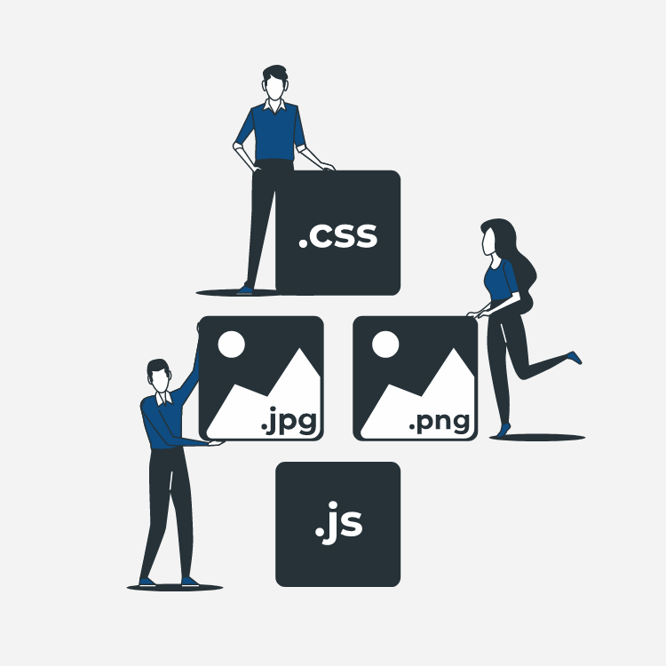
06
TECHNOLOGIES
TO BE USED

Slide 35





Front End
Database
Version Controlling
Back End
Collaboration Tools

Slide 36

07
WORKLOAD DISTRIBUTION

Slide 37
Saneru Akarawita
Registered Customer
System Admin
Chirasi Amaya Walpola
Hotel Manager
Super Admin
Harini Jayawardhana
Band Manager
Photography Company
Kaveesha Muthukuda
Decoration Company
Photography Company

Slide 38

Thank You !
Any Questions?

